Slide 1
Secure Token Development and Deployment
Dmitry Khovratovich and Mikhail Vladimirov,
University of Luxembourg and ABDK Consulting

Slide 2


ERC-20 tokens and ICO
ERC-20 standard: developed in late 2015, de-facto standard for fungible assets.
Many enterprises decided to raise funds via Initial Coin Offering (ICO):
Users deposit money to a dedicated web-service or Ether to a bookbuilding contract;
The total investment is converted to a fixed number of tokens;
A smart contract is issued, where each user gets tokens according to his investment share.
In 2016, 64 ICOs gathered over $103 mln. (CoinDesk)

Slide 3
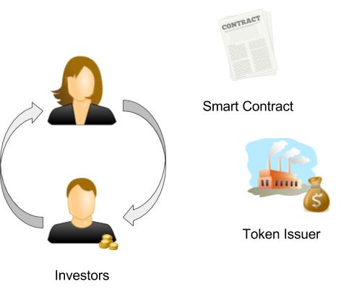
ERC-20 functions
Function | Description
totalSupply() | Total number of tokens in circulation
balanceOf(A) | Number of tokens belonging to A
transfer(A,x) | Send x tokens to A
transferFrom(A,x) | Withdraw x tokens from A
approve(A,x) | Approve A to withdraw tokens from me
allowance(A,B) | How much B can withdraw from A

Slide 4

Security
Security of the ICO process and contract maintenance is a vital issue.
Threats:
Token loss due to contract misbehavior;
Availability loss: external contracts (say, exchanges) can not interact with the token contract due to its errors.
Vulnerabilities:
Insecure code;
Error-prone interface.

Slide 5
ERC-20 functions
transfer(address _to, uint256 _value) returns (bool success) –
Send _value amount of tokens to address _to
balanceOf (address _owner) constant returns (uint256 balance) –
number of tokens belonging to address
totalSupply() constant returns (uint256 totalSupply) –
total number of tokens
approve(address _spender, uint256 _value) returns (bool success) –
approve the spender to withdraw tokens from my account, multiple times;
allowance(address _owner, address _spender) constant returns (uint256 remaining)
how much the spender can withdraw
transferFrom(address _from, address _to, uint256 _value) returns (bool success) – transfer tokens from t

Slide 6
Current Insecurity: Implementations

Slide 7
Exceptions in Solidity
C2
C1
X=C1.F(10);
….
X = C1.call(…”F”…)
function F(uint x)
returns uint{
If(x>42) throw;
else return 3}
C1.F() can not catch exceptions;
C1.call() can not get returned values.
Exceptions must be for exceptional events!

Slide 8
Exceptions instead of value return
Code example:
function transferFrom(address _from, address _to, uint _value) returns (bool success) { var _allowance = allowed[_from][msg.sender]; balances[_to] = safeAdd(balances[_to], _value); balances[_from] = safeSub(balances[_from], _value); 1 allowed[_from][msg.sender] = safeSub(_allowance, _value); Transfer(_from, _to, _value); return true; }
function safeSub(uint a, uint b) internal returns (uint) { assert(b <= a); return a - b; }

Slide 9
Exceptions instead of value return
Code example:
function transferFrom(address _from, address _to, uint _value) returns (bool success) { var _allowance = allowed[_from][msg.sender]; balances[_to] = safeAdd(balances[_to], _value); balances[_from] = safeSub(balances[_from], _value); allowed[_from][msg.sender] = safeSub(_allowance, _value); Transfer(_from, _to, _value); return true; }
If the _from balance is insufficient, or allowance is too low, exception is thrown (must return false by the standard).

Slide 10
Relying on future exceptions
function transferFrom(address _from, address _to, uint _value) returns (bool success) { var _allowance = allowed[_from][msg.sender]; balances[_to] = safeAdd(balances[_to], _value); balances[_from] = safeSub(balances[_from], _value); allowed[_from][msg.sender] = safeSub(_allowance, _value); Transfer(_from, _to, _value); return true; }
The _to balance is always increased.
In order to revert the operation, the allowance decrease MUST throw exception.

Slide 11
Overflows in SafeMath
function safeMul(uint a, uint b) internal returns
(uint) { uint c = a * b; assert(a == 0 || c / a == b); return c; }
Code relies on the (undocumented) behavior of overflow in Solidity.
First creates overflow, then tries to detect it.
The overflow might be treated differently in the future, so potential compatibility loss.
Same with safeAdd.

Slide 12
Current Insecurity: the Approve() function
Attack on the ERC-20 standard

Slide 13
Approve
approve(address _spender, uint256 _value)
_spender can withdraw from your account up to _value tokens.
Subsequent approve() overrides the previous one.
transferFrom(address _from, address _to, uint256 _value)
spender withdraws _value tokens from _from and sends them to _to.
transferFrom logs a Transfer event where the spender is not listed(!).

Slide 14
Attack
Alice approves Bob with N tokens;
Alice decides to change Bob’s allowance and approves him with M tokens;
Bob notices the last transaction before it is mined and withdraws N tokens from Alice sending them to Carol.
After Alice’s transaction is mined, Bob withdraws M more tokens from Alice sending them to Carol, thus taking M+N in total.
Bob’s actions are not properly logged: the Transfer event gives the addresses of Alice and Carol, not Bob.
Even more confusion if Carol has allowance from Alice as well.

Slide 15
Our suggestion: atomic approval and new events
1) function approve( address _spender, uint256 _currentValue, uint256 _value) returns (bool success)
If current allowance for _spender is equal to _currentValue, then overwrite it with _value and return true, otherwise return false.
2) event Transfer( address indexed _spender, address indexed _from, address indexed _to, uint256 _value)
3) event Approval( address indexed _owner, address indexed _spender, uint256 _oldValue, uint256 _value)

Slide 16
Our approach

Slide 17
Clear requirements and behavior
Define functional requirements for the token contract and API;
Describe all use cases;
State security claims explicitly.

Slide 18
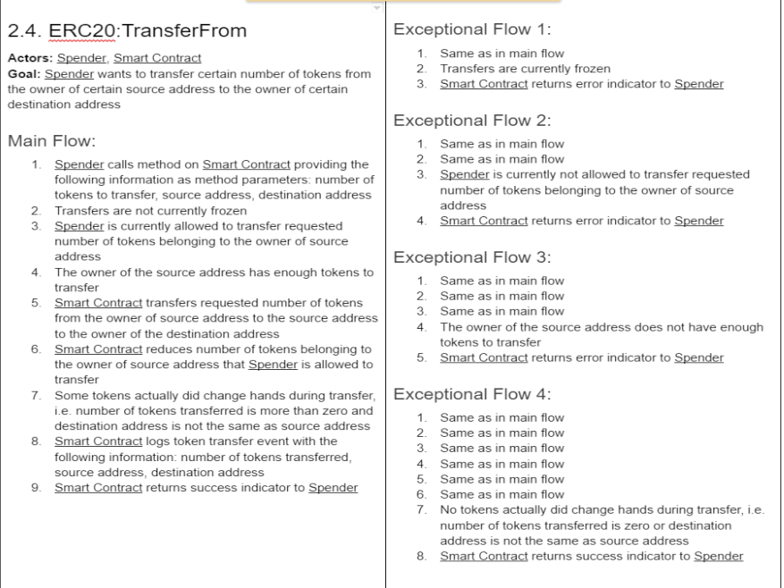
Detailed use cases

Slide 19
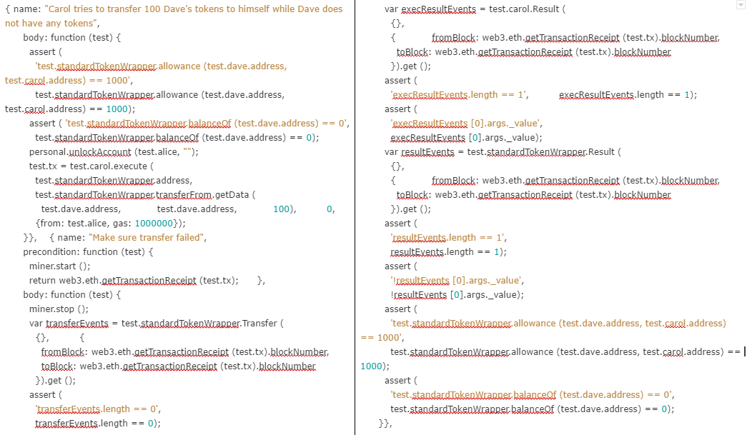
Elaborate tests

Slide 20
Full compliance to ERC-20 and predictable behavior
function transferFrom (address _from, address _to, uint256 _value)
returns (bool success) {
if (allowances [_from][msg.sender] < _value) return false;
if (accounts [_from] < _value) return false;
allowances [_from][msg.sender] =
safeSub (allowances [_from][msg.sender], _value);
if (_value > 0 && _from != _to) {
accounts [_from] = safeSub (accounts [_from], _value);
accounts [_to] = safeAdd (accounts [_to], _value);
Transfer (_from, _to, _value);
}
return true;
}

Slide 21
Deployment and Administration: Dedicated UI

Slide 22
UI for smart contract interaction
Smooth user experience is crucial for security
Runs in browser, Mist is not necessary;
Connects to local or remote node;
Accounts and/or passwords synced across devices;
Plugin support to create administrator consoles.

Slide 23
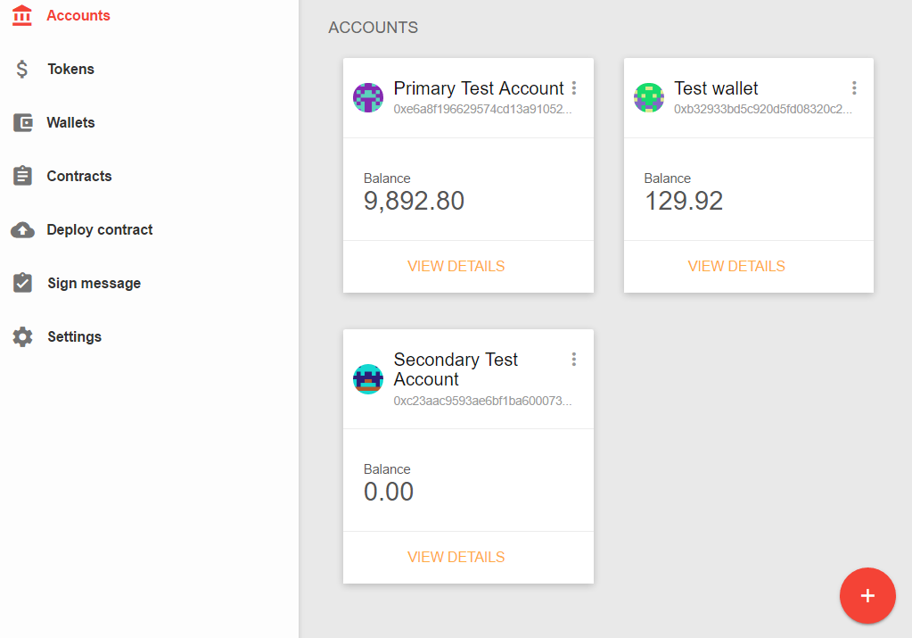

Slide 24
Example: Smart Token Wallet
Connects to a remote node (Amazon EC2);
Static file, works in any browser/OS locally.
For users:
Balance and exchange rates for tokens alone and combined;
Approve and allowance functionality;
For token administrators:
Fool-proof token resupply;
Freezing transfers;
Multisig administration.

Slide 25
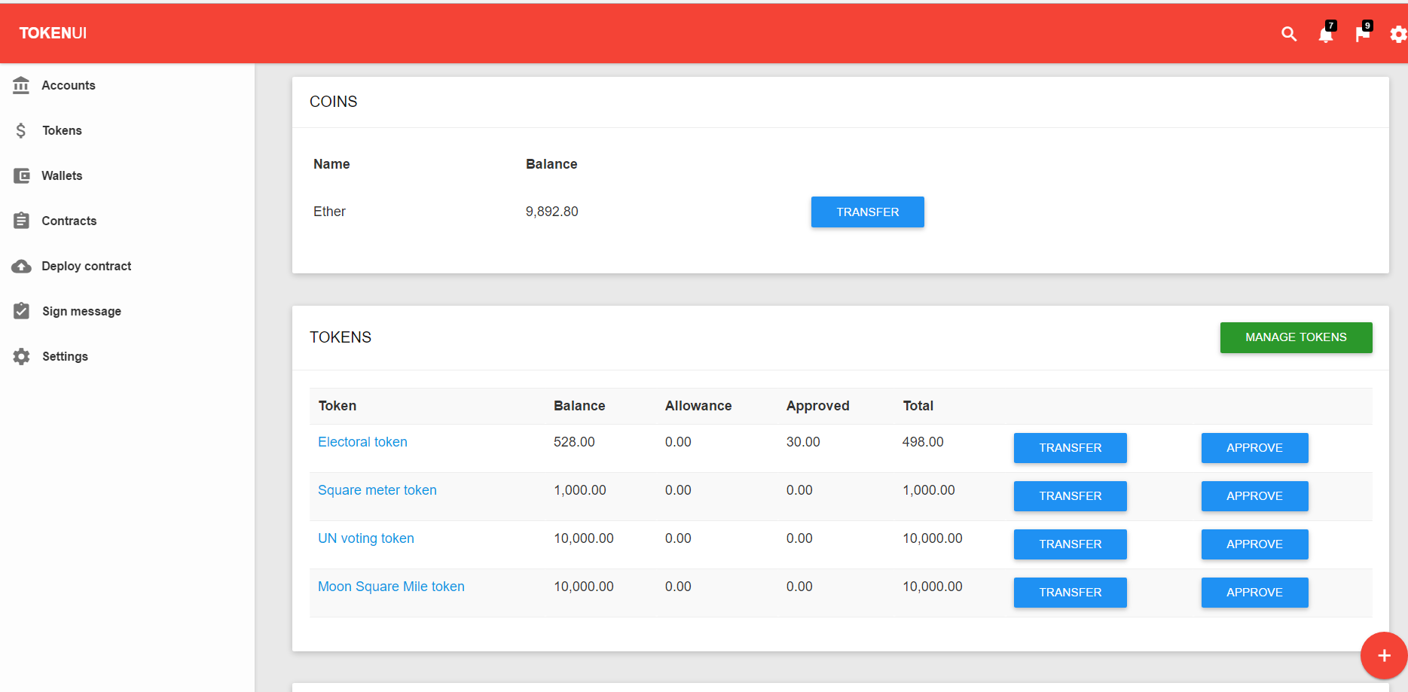

Slide 26

Secure code, smart UI?
www.abdk.consulting

